Slide 1
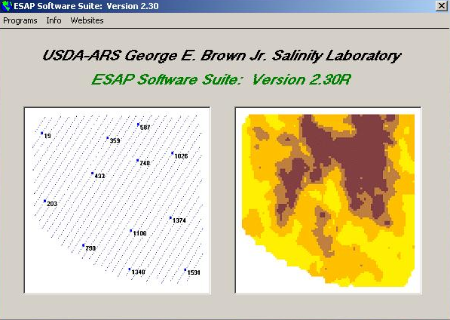
Electromagnetic Sampling Analysis and Prediction (ESAP v. 2.35)
For signal processing data collected with emi instrumentation

Slide 2
Overview
How to import and edit survey data generated from and EM38 survey into ESAP for analysis
How to use ESAP to generate sampling designs from field measurements
How to create a map of various soil characteristics

Slide 3
What is esap?
ECe (or Salinity) Sampling, Assessment, and Prediction
A statistical software package for estimating field-scale, spatial soil property patterns from EMI signal data.
Developed at the USDA-ARS US Salinity Laboratory in Riverside, CA and specifically designed to facilitate cost-effective, technically sound, soil salinity assessment and data interpretation techniques.
Available for download free of charge online at: https://www.ars.usda.gov/pacific-west-area/riverside-ca/us-salinity-laboratory/docs/esap-model/

Slide 4
Core Modules of ESAP
ESAP-RSSD (Response Surface Sampling Design)
Examine, analyze, & summarize EC_{a} survey data
Generates optimal soil sampling designs from sensor data
ESAP-Calibrate
Converts survey data into predicted soil salinity (a/o other soil properties)
Diagnose & identify primary soil properties influencing survey data
Generates multiple field summary statistics
Generates prediction data (used for making spatial maps)
ESAP-SaltMapper
1-D transect plots and 2-D raster maps
Tile line maps, calculate tile line locations, diagnose potential tile line problems

Slide 5
Support modules of ESAP
ESAP-SigDPA (Signal Data Pre-processing Algorithm)
Tool to pre-process signal data into format used and recognized by core Modules.
Perform signal data QA/QC and validity checks, scale conversion, and row (transect) identification & assignment.
ESAP-DPPC (Dual Parallel Pathway Conductance) Calculator
Convenient to use calculator version of the 1989 Rhoades DPPC model
Used for direct prediction of salinity from spot 4-probe or EM survey data given soil temperature, texture, and moisture measurements (or estimates)

Slide 6
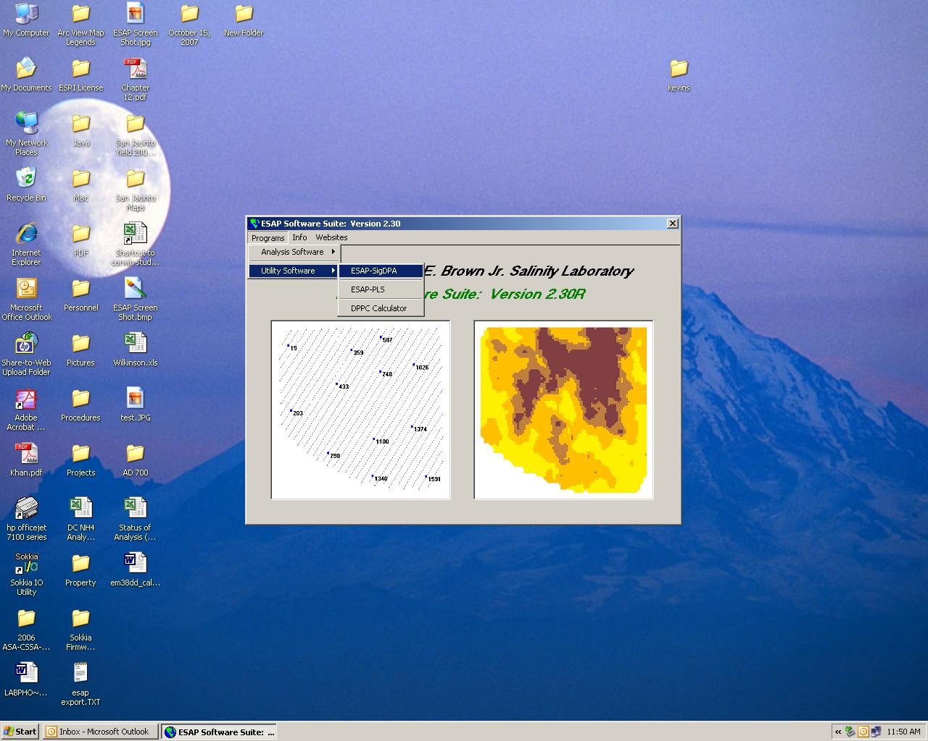
Using sigdpa to edit em data for sample design
Open ESAP and under “Programs” select “Utility Software” and then select “ESAP Sig-DPA”

Slide 7
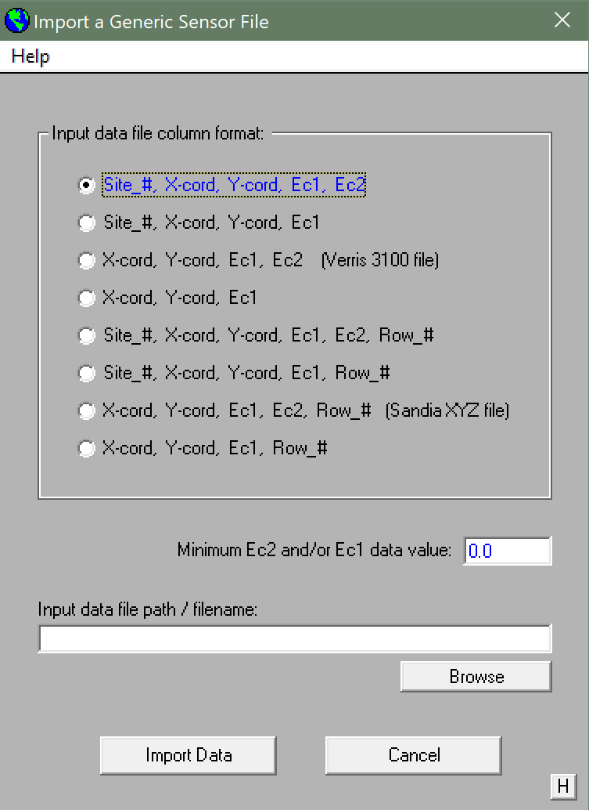
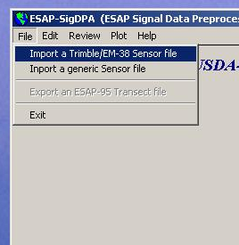
Importing Data into sigdpa
Under “File” select to Import a generic Sensor file
Select the appropriate file format
Usually Site #, X, Y, Ec 1, Ec 2
Browse for the EM38 .csv generated from DAT38MK2 but MAKE SURE TO DELETE the column headers

Slide 8
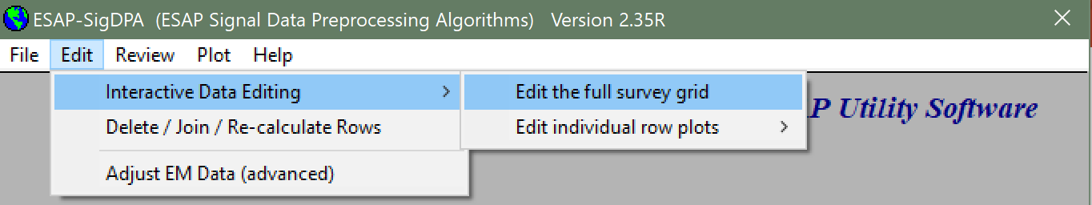
Removing edges to generate transect data
Under “Edit” Select “Interactive Data Editing” and then “Edit the full survey grid”

Slide 9
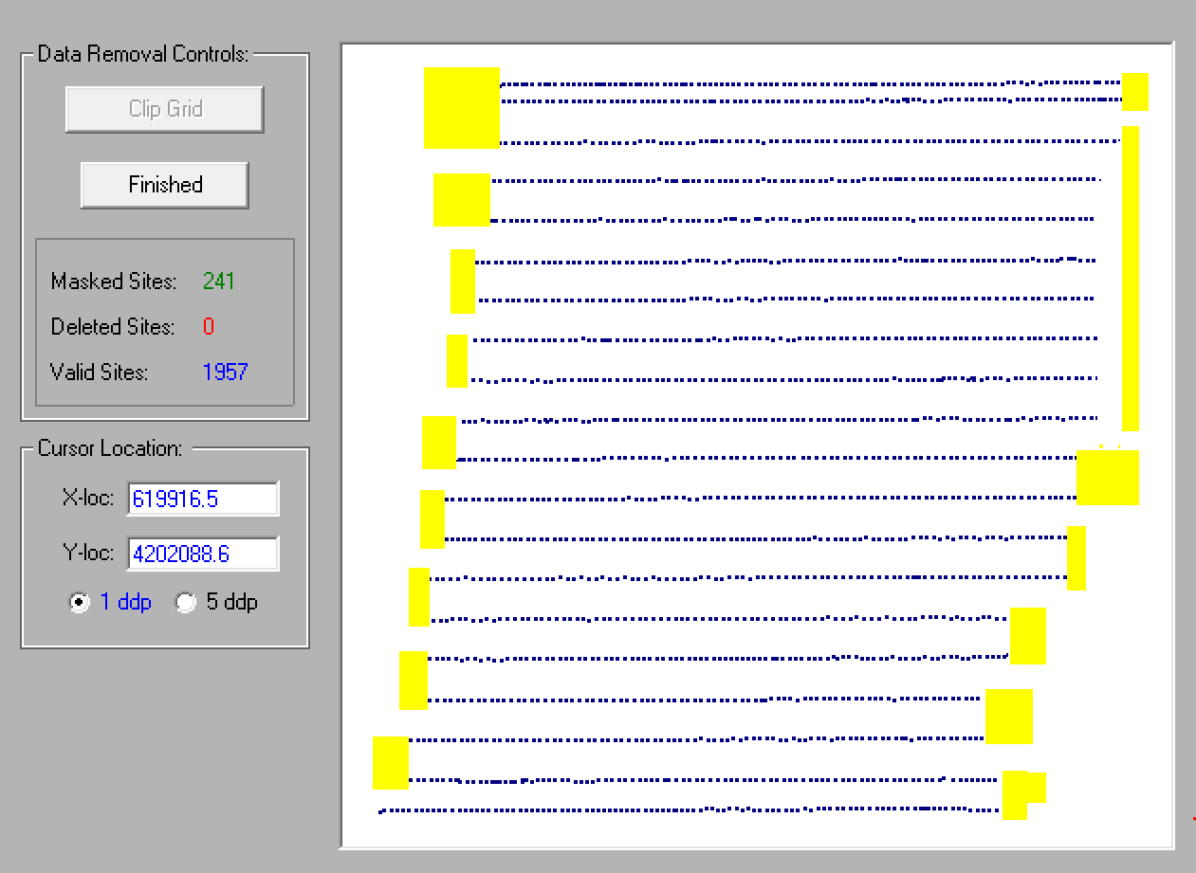
Removing edges to generate transect data
Under “View” select “Display full map (max resolution)”
Click the “Clip Grid” Button and highlight the areas of the map you want clipped
The areas you remove will be highlighted in yellow
Click “Finished” and then mask and delete the clipped portion with the button that appears at the bottom of the screen

Slide 10

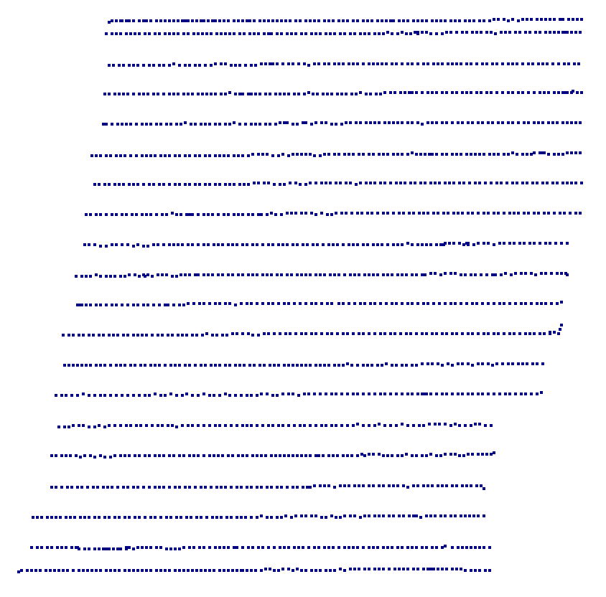
Before and after clipping

Slide 11
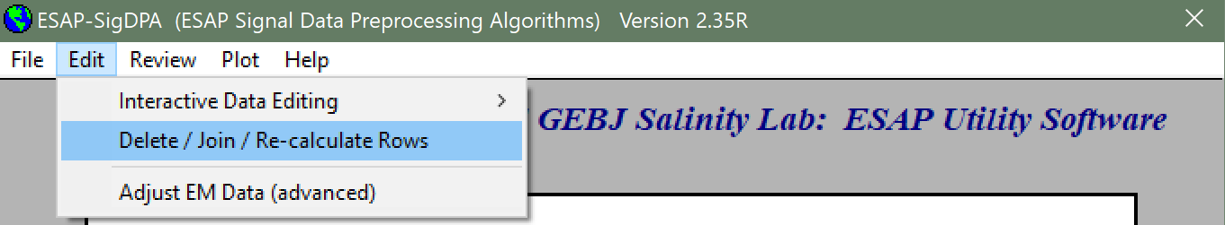
Numbering rows for transect data
Under “Edit” Select “Delete/Join/Re-Calculate Rows

Slide 12
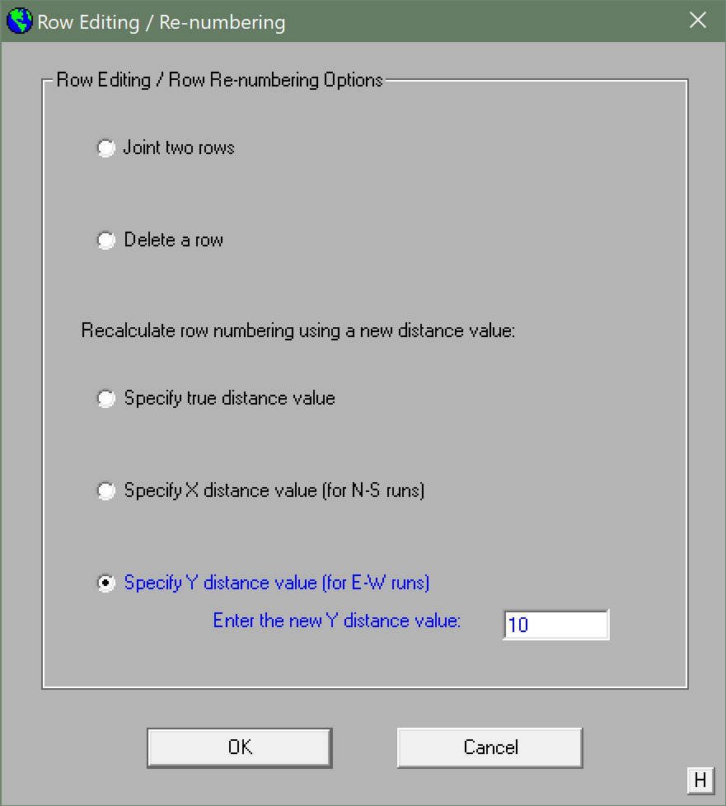
Adding numbers to rows
Check the “Specify Y distance value” (or X distance value if the transects run north and south)
Input the distance between transect passes (note: it is better to underestimate than overestimate here)
Press “OK”

Slide 13
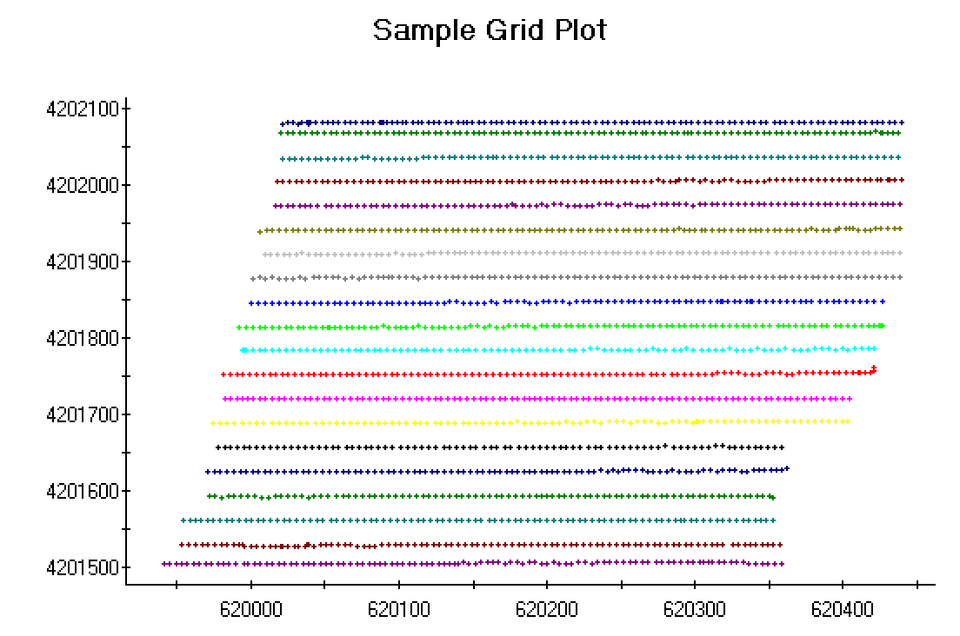
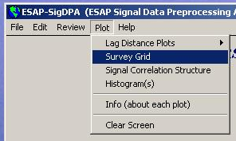
Select “Survey Grid” under “Plot” to check that each transect has a distinct color in the correct location

Slide 14
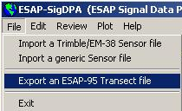
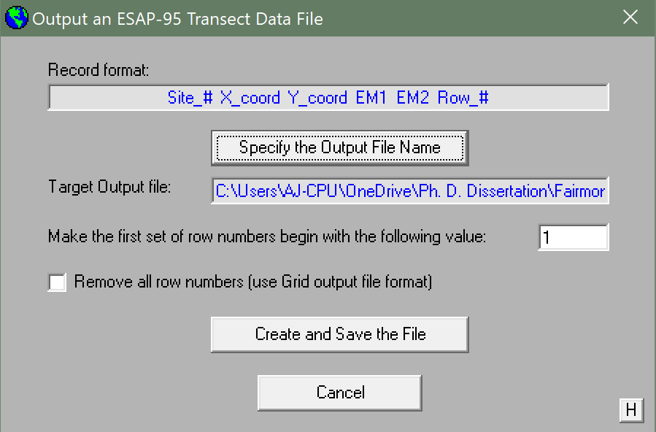
Exporting transect data to use in esap-rssd
Once the transects are labelled correctly:
Under “File” select “Export an ESAP-95 Transect file”
Specify the name and location of your output file
“Create and Save the File”
You may now exit Sig-DPA

Slide 15

Generating a sampling design
ESAP-RSSD will take EM38 Transect data to statistically locate the best sampling locations for correlating soil characteristics to EM38 readings
Open ESAP-RSSD from the ESAP main menu under “Programs” and “Analysis Software”

Slide 16
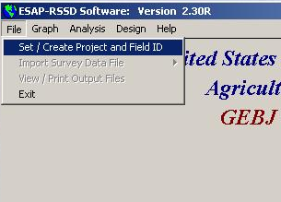
Creating new projects
Select Set/Create Project and Field ID under “File” menu.

Slide 17

Creating new projects
Create Project in “Create/Set Project” window.

Slide 18
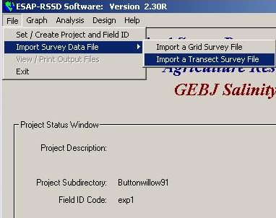
Importing data
Select Import a Transect Survey File under the “File” and “Import Survey Data File.”

Slide 19
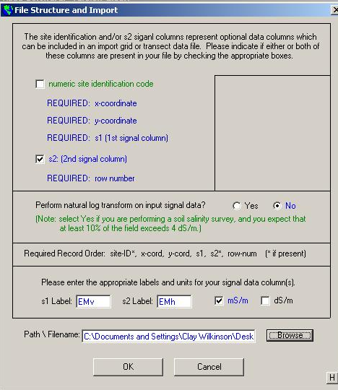
Importing data
Browse to locate file we created in Sig-DPA, click on it, then click “OK” in the “File Structure and Import” window.

Slide 20
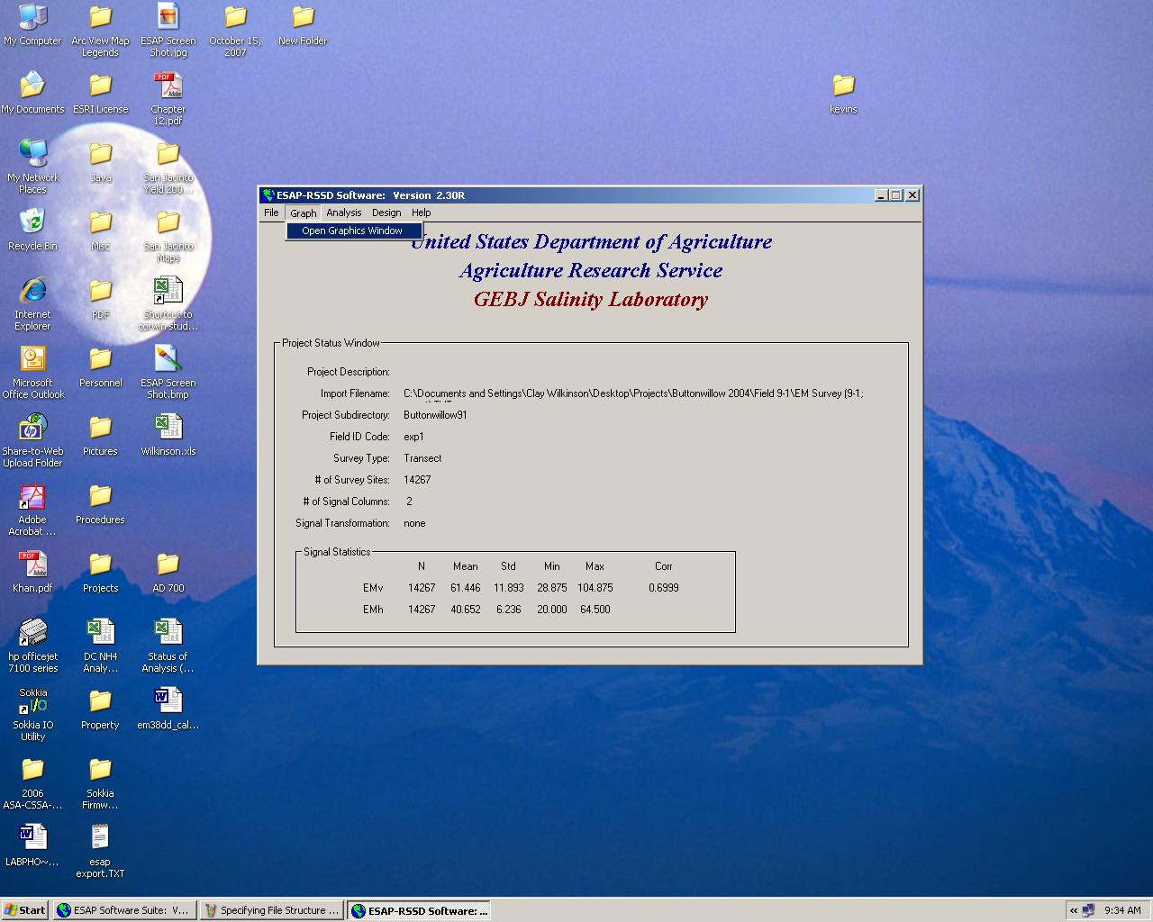
Checking assumptions
Select Open Graphics Window under “Graph” menu.

Slide 21
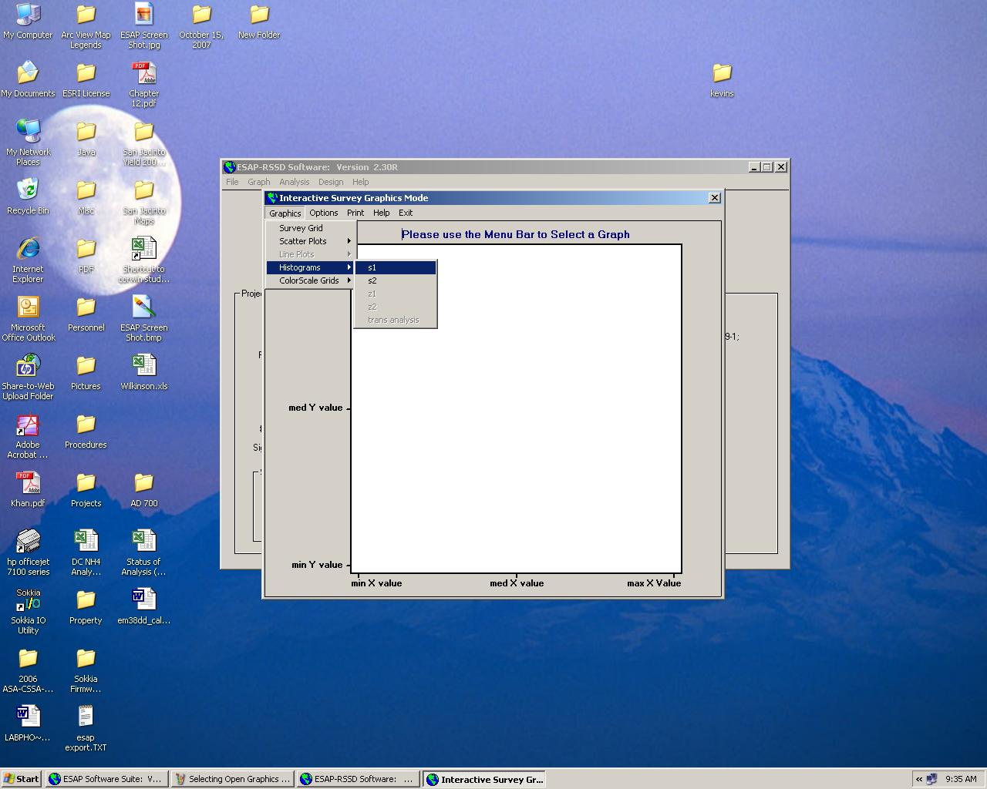
Checking for normality
RSSD sampling designs require that the EM values are normally distributed to satisfy statistical assumptions
To check we must look at histograms of both EM signals ( Graphics → Histograms → s1/s2

Slide 22
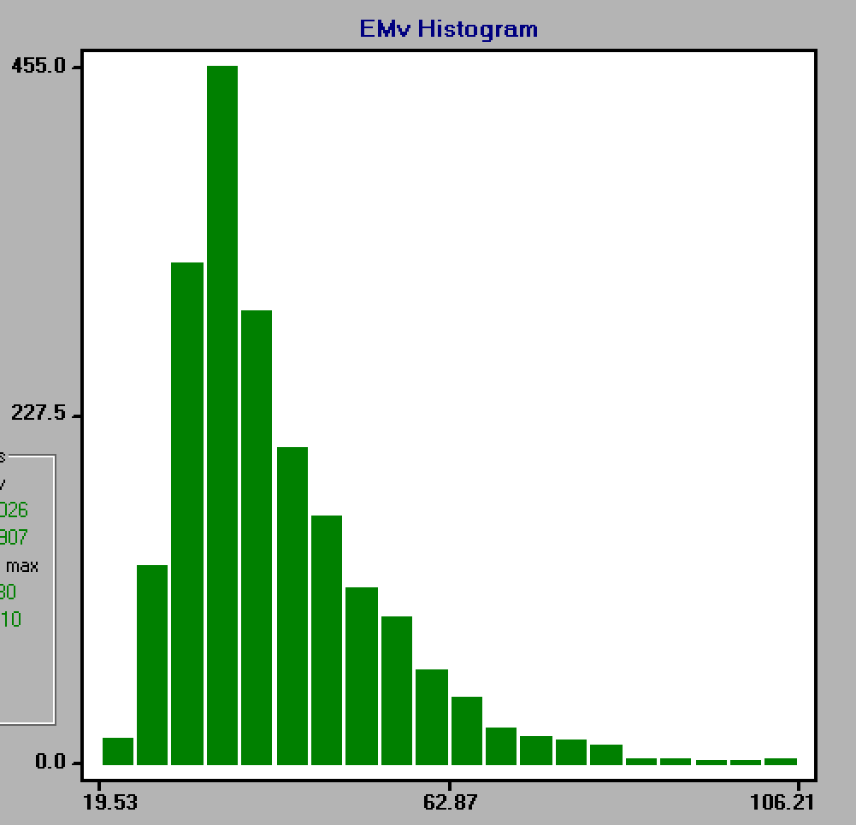
Non-normal data and log transformation
Often EM data is non-normally distributed.
This is because most fields only have small areas of lahig salinity, and not the entire field
To correct for this, we must log-transform the data

Slide 23
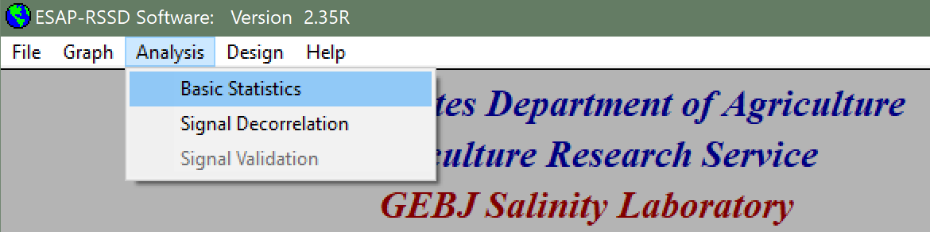
Log Transforming data
To log transform the data, under “Analysis” select “Basic Statistics”

Slide 24
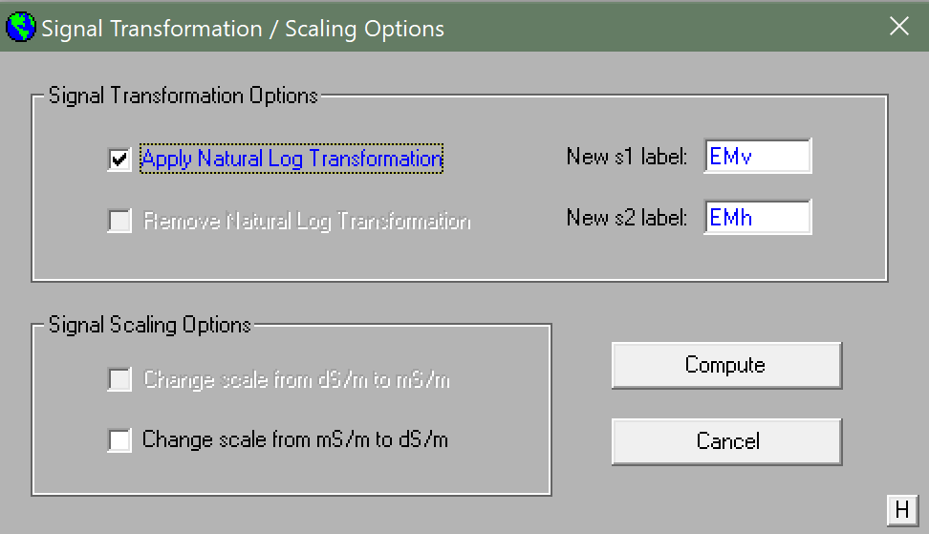
Log transforming data
Check “Apply Natural Log Transformation” and press “Compute”

Slide 25
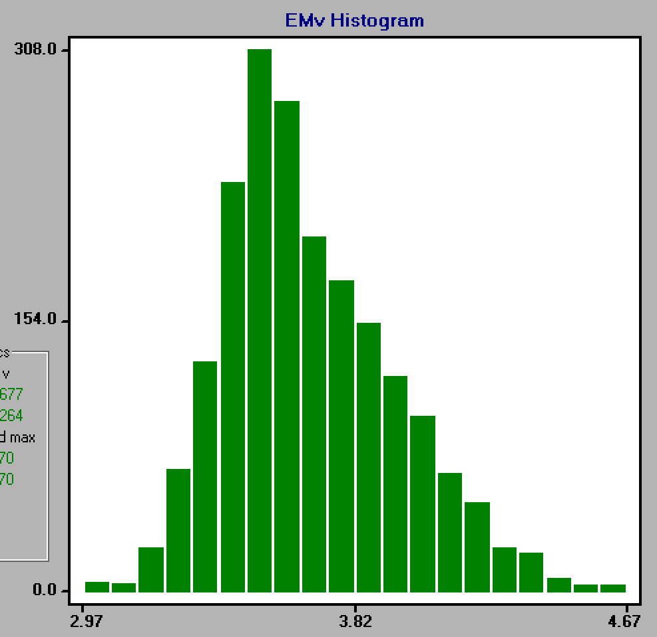
Checking new distribution
Check to see that your log transformed data is more normally distributed in the graphics menu again.
No Transformation
Log Transformation

Slide 26

Signal decorrelation
Select Signal Decorrelation under the “Analysis” menu.

Slide 27
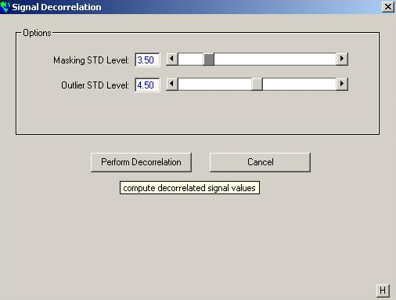
Signal decorrelation
Click “Perform Decorrelation” button.

Slide 28
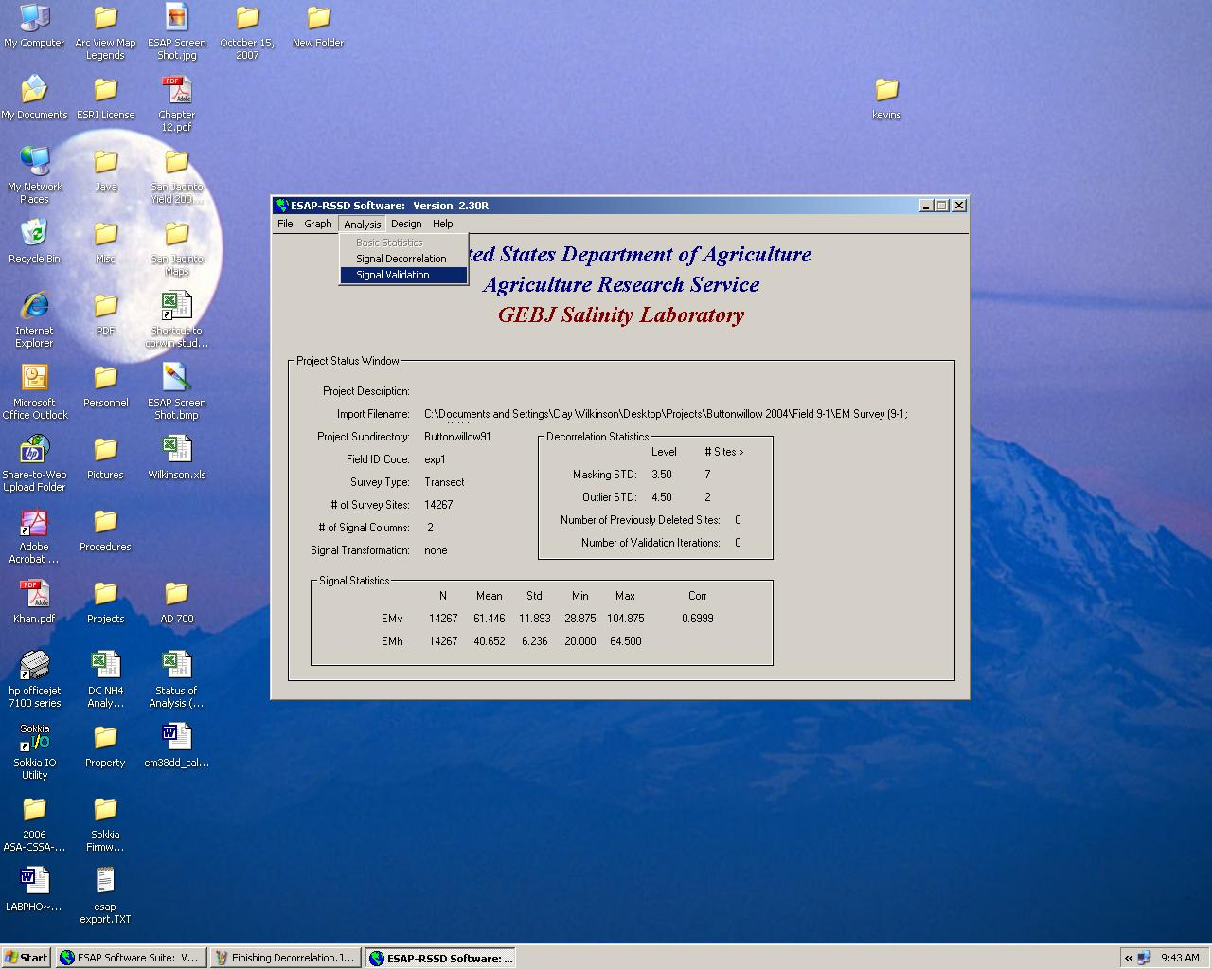
Signal Validation
Select Signal Validation from the “Analysis” tab

Slide 29
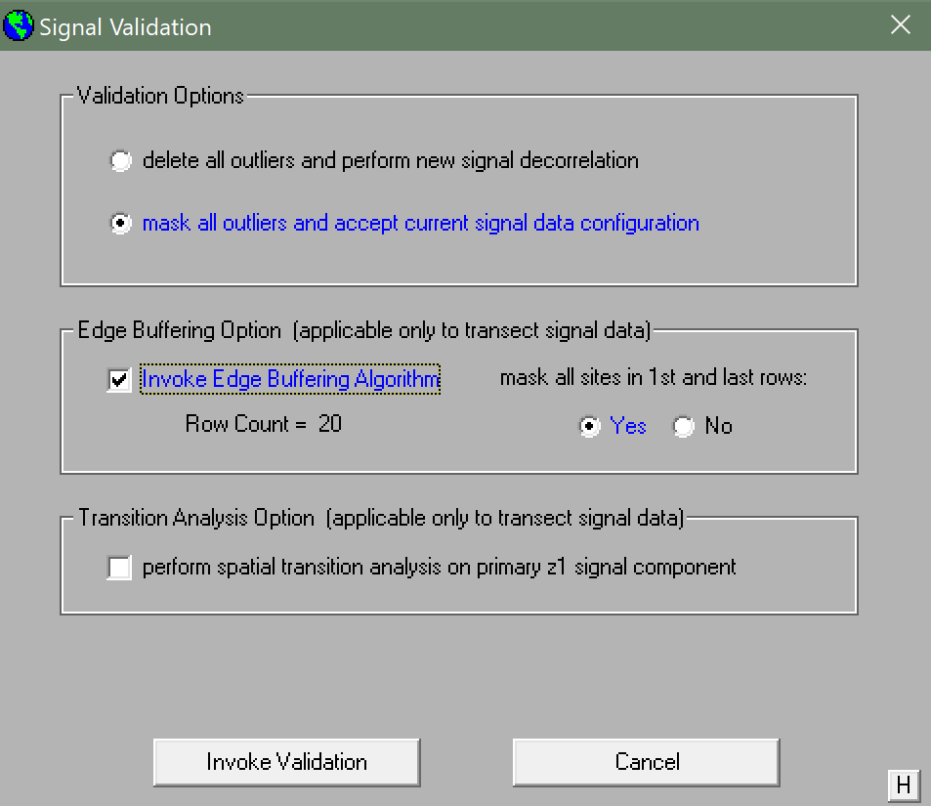
Signal validation
“Mask all outliers and accept current signal data configuration”
Invoke edge buffering algorithm (optional)
“Invoke Validation”

Slide 30
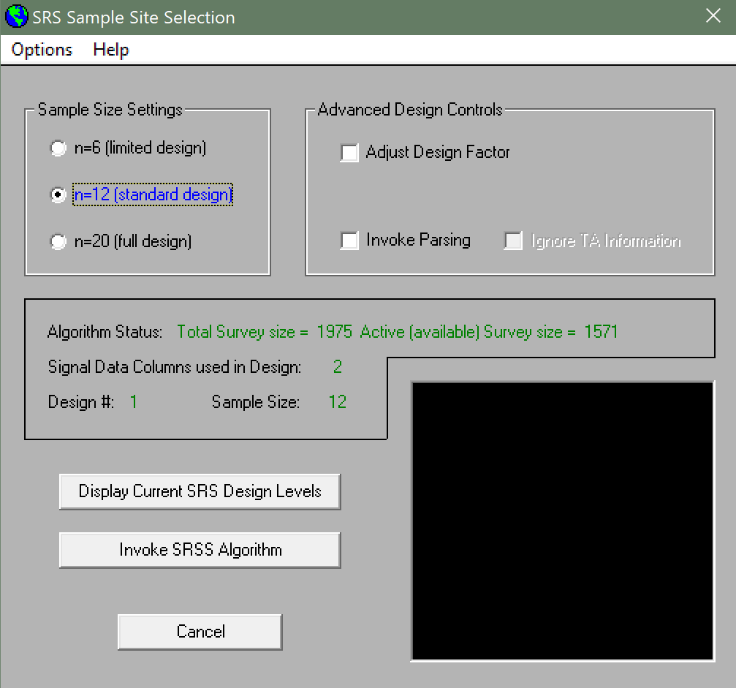

Sample design
Select Signal Validation from the “Analysis” tab
“Invoke SRSS Algorithm”

Slide 31
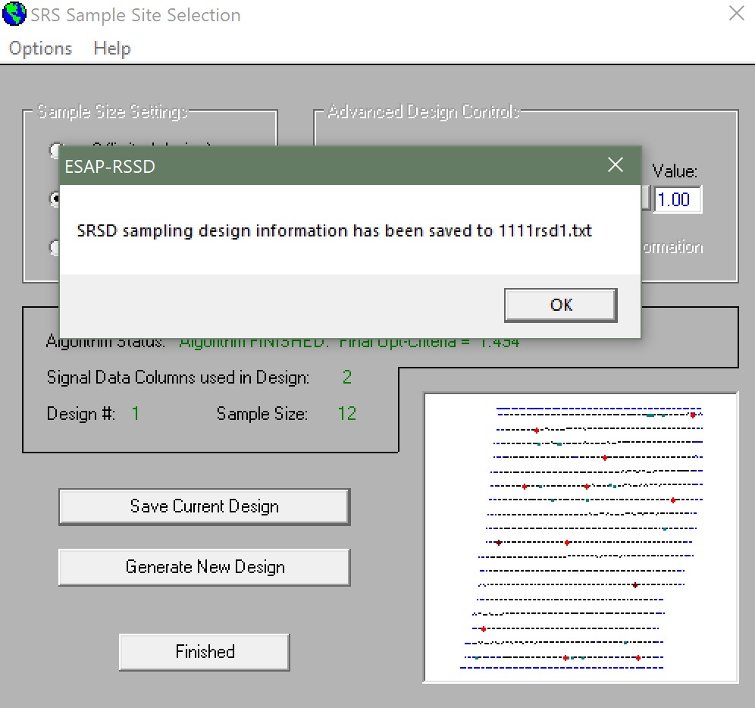
Sample design
“Save Current Design”
Try to have Opt-Criteria 1.30 or less
Change design factor and/or invoke parsing to obtain best results
Generate as many designs as needed to pick best result

Slide 32
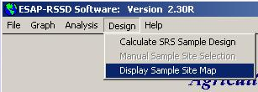
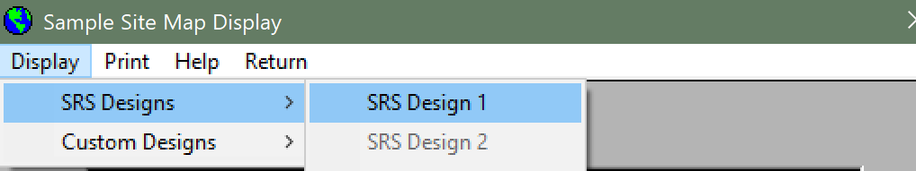
Sample design
After clicking “Finished”, from the main menu, open the sample site map

Slide 33
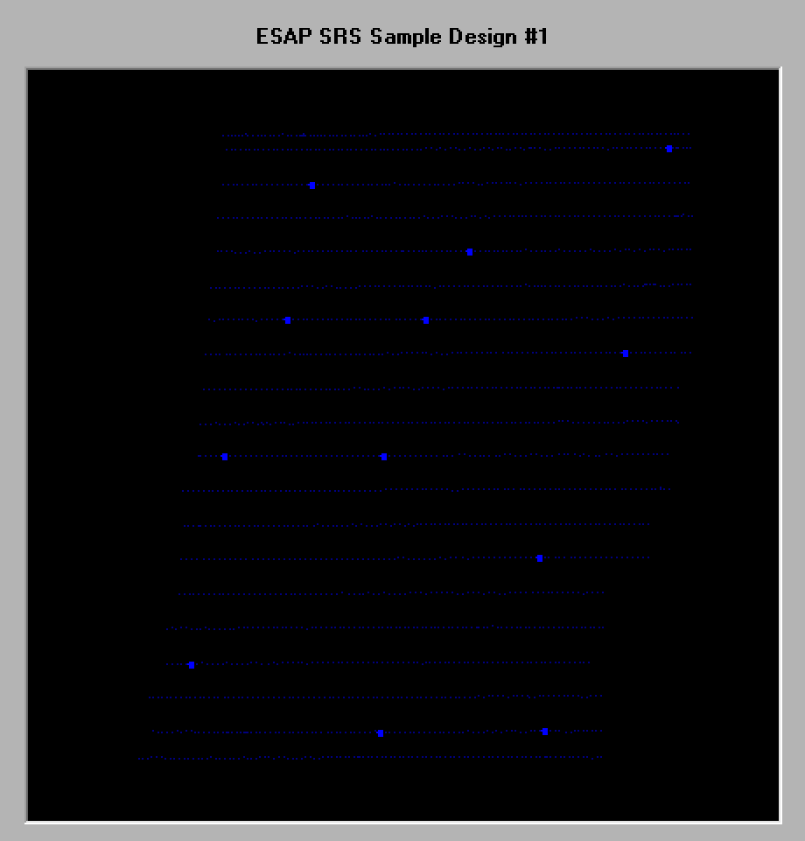
Sample design
You may now view and print your sample map
To view gps coordinates and statistical results, open the project folder on the desktop and go to the “rsd1” and “gps1” files

